Slide 1
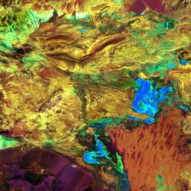
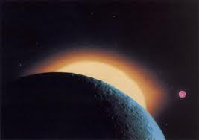
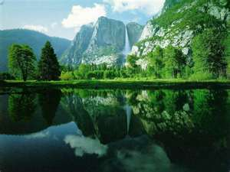
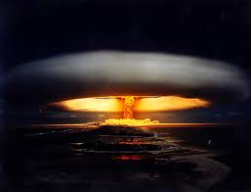
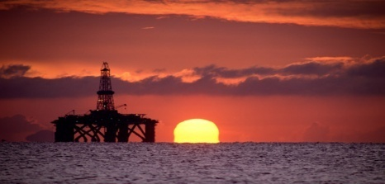
The Zion movement: project x
What was!
The opec tradition
What is!
What will!
Oil refinery and the environment
Ordinary hero's
The world crisis are we to help

Slide 2
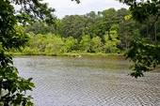
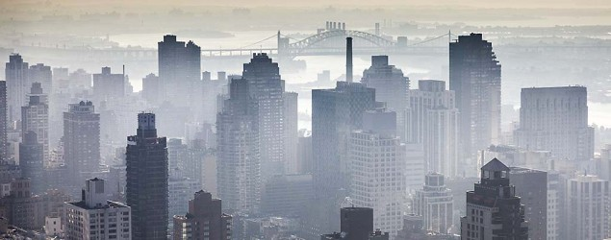
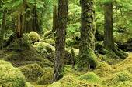
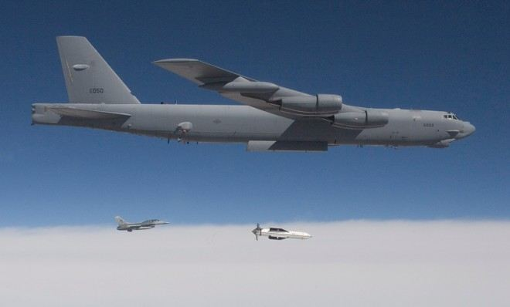
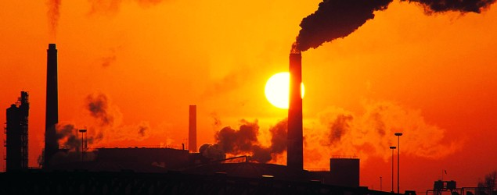
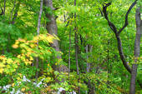
The Zion movement is to teach protect and inform our community
Destroying this
For this
Environmental destruction
Trading paradise

Slide 3
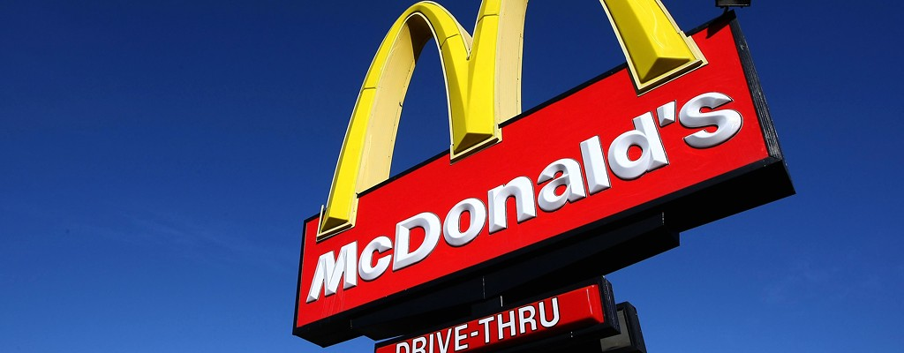

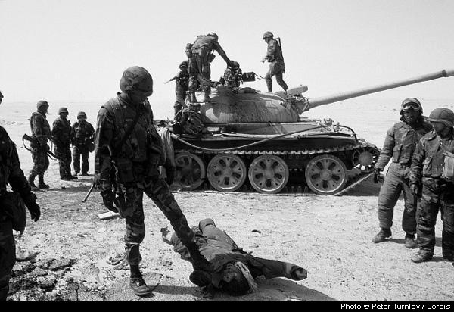
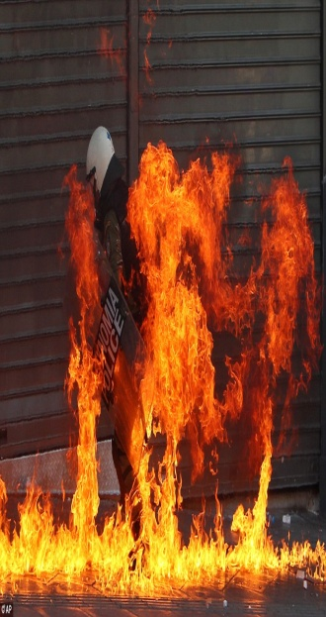
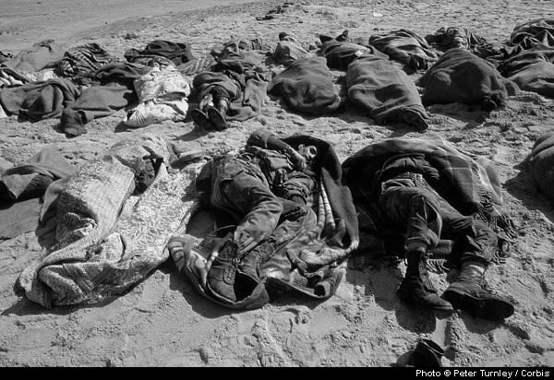
Bad health, bad food, bad intentions.
Stealing a planet
The cost of over weight because fast food in our community is killing us.
Diabetes, heart diseases that
causes heart attacks, heart rites, sugar, bronchitis and cancer. Etc.
pollution
Destruction of a nation of people; By another race
Cause and effect. Seeking control of our life and planet.
attacks
War machines & Death!
Lost souls

Slide 4
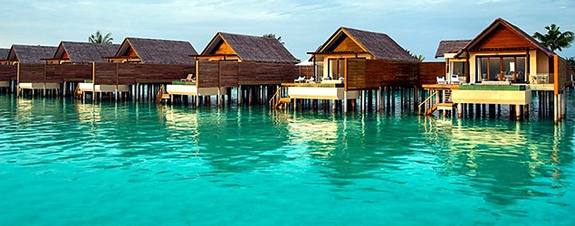
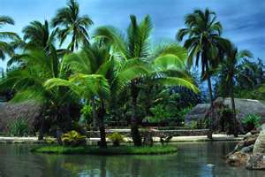
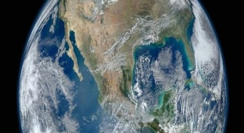
When the world we owned is taken by villiants who want our home for themselves.
No matter what the circumstances, we are in and cannot get out
this is home, sweet home.
we are living here and whatever happened to the planet is going to affect us all as well as anyone else here. we’re caught up in the mess even though we have nothing to do with what is happening, Are we to help them in their effort of cleaning up to rebuild the planet and the environment, or should we let them reap what they sow I think they should and we shouldn’t help
They was told of the danger but they would not listen because they wanted control of our planet and home and they didn’t care about what they of to do to get it, they would destroyed themselves to achieve their goal now they’re changing our planet
W J o s e p h (velvet ) w

Slide 5
The Anthem
When you feel like you want to grow but someone standing in your way
And it seem like all you trying to reach around them it is their duty every day
To keep you from being what the creator made you and exploit you all the way
Then you called upon the father on you knees you humble pray
They keep on deceiving you keep on believing all the way
We are children of the king, child of a king!, all they’ve done to us, take and claim all that we have and possessed, we are child of the creator, and for ever will be children of the universe and child of a king.
Cho
Rejoice for them for they have shown you, that you are special so their deeds against
Us make us realize the things we would normally taken for granthage
Now we know that we’re special, the children of the creator, perfect and strong, and great in abundant so all they’ve done to us we’ve survived, we’re still children of the father, and we keep on growing because we are child of the king.
Cho
We are child of the king, child of a king!, all they’ve done to us take and claims all that we have and possessed we are child of the creator. and for ever will be children of the universe and child of a king.

